Slide 1
Resampling Methods
Chapter 5 – Introduction to Statistical Learning with Applications in R
Presented by Levi Waldron, Dec 5 2014

Slide 2
Introduction
Resampling methods involve fitting the same statistical method repeatedly to different subsets of the training data
Two commonly used methods are cross-validation and bootstrap.

Slide 3
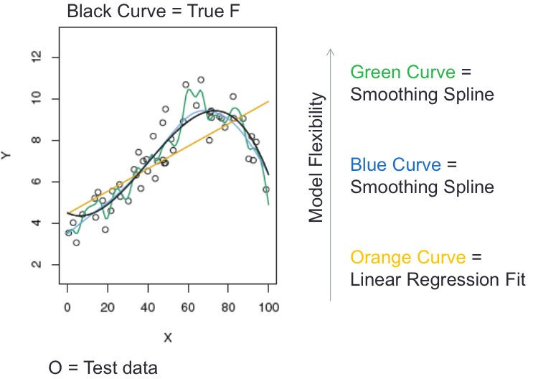
Motivating example for cross-validation: recall chap. 2
O = Training data

Slide 4
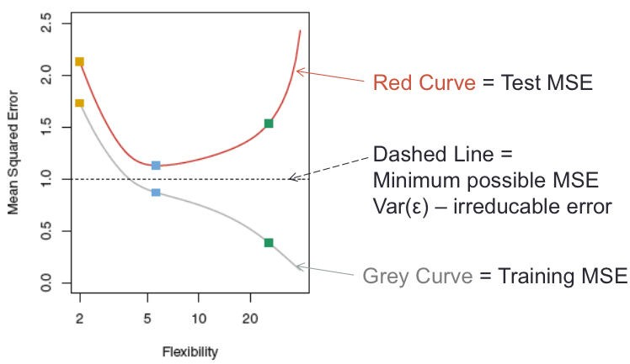
Optimal MSE achieved by best bias-variance trade-off
MSE in training and testing samples

Slide 5
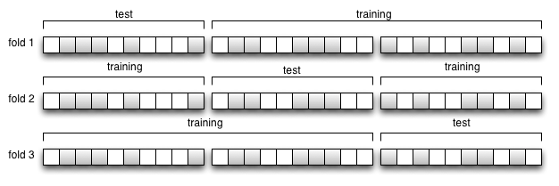
Resampling Methods
Resampling simulates multiple training and/or test sets by taking random re-samples from the available sample
Cross-validation: generate training and test sets without replacement
Figure: Three-fold cross-validation

Slide 6
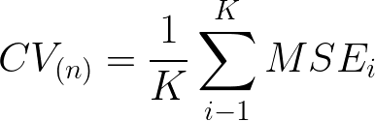
K-fold cross-validation in words
Randomly partition the sample (size n) into K (K ≤ n) partitions of size ~ N/k.
Define K “folds”, each using a different partition as the validation set. Use non-validation partitions for training.
For each fold, fit a model from training set, calculate accuracy on validation set
Average validation accuracy across folds:
Notes:
CV_{(n)} = \frac{1}{K} \sum_{i-1}^K MSE_i

Slide 7
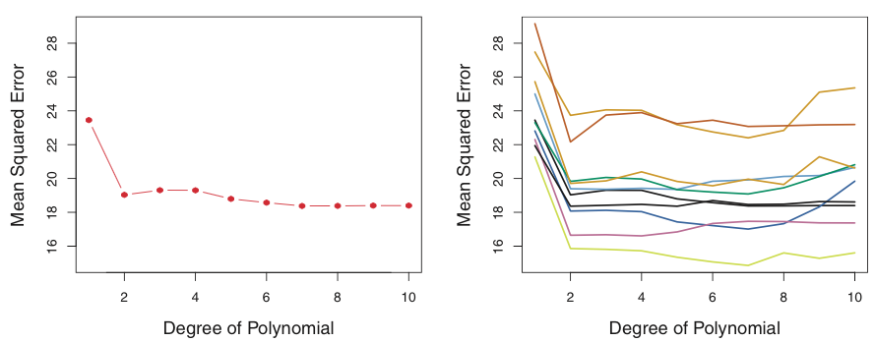
ISLR Figure 5.2: Variability in training/test approach
Randomly partitioned Auto dataset into training and test
Used polynomial fits of increasing degree
One training/test split
Ten training/test splits

Slide 8
Bias-variance trade-off in cross-validation
As with model fitting, there is a bias-variance trade-off in the selection of K.
Key point: we are talking about bias and variance of the overall MSE estimate, not between the folds.

Slide 9

Bias-variance trade-off in cross-validation
2-fold CV is a high-bias estimate:
training on fewer samples causes upward bias in MSE
Leave-one-out CV is a low-bias estimate:
training on n − 1 samples is almost as good as on n samples (almost no bias in prediction error)
What about variance?
Recall for independent samples:
But for highly correlated samples,

Slide 10
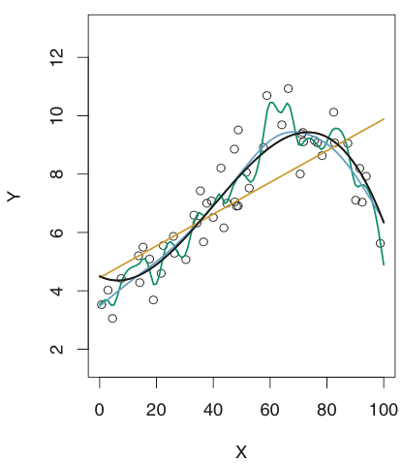
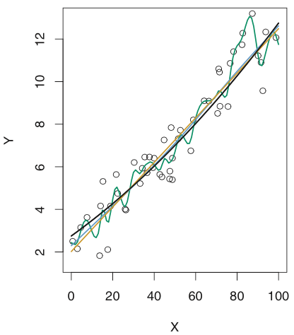
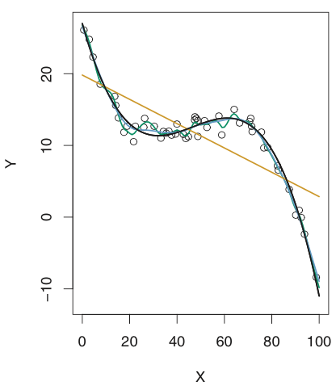
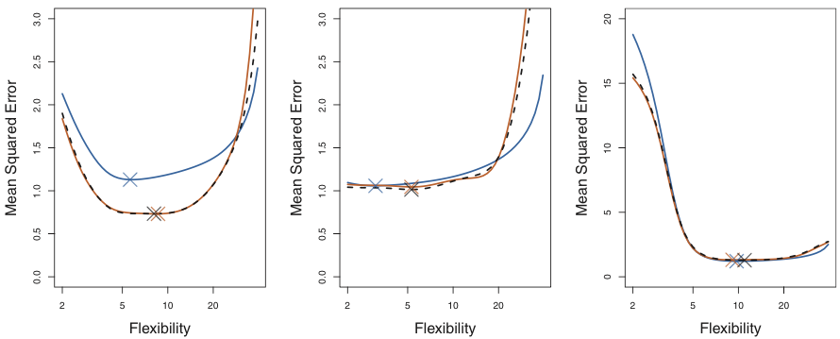
Figure 5.6: true and estimated test MSE for simulations from Chap. 2
True test MSE LOOCV estimate 10-fold CV
X = optimum

Slide 11
Bias-variance trade-off in cross-validation
2-fold CV -> high-bias, low-variance
Leave-one-out CV -> low-bias, high-variance
Computationally, K models must be fitted
5 or 10-fold CV are very popular compromises
Side note: Leave-one-out CV estimate can be calculated analytically for linear regression, without resampling

Slide 12
Cross-validation summary
In prediction modeling, we think of data as training or test
Training set error always decreases with more flexible models
CV estimates test set error from training set
Test set error as a function of model flexibility tends to be U-shaped
The low point of the U represents the optimal bias-variance trade-off, or the most appropriate amount of model flexibility

Slide 13
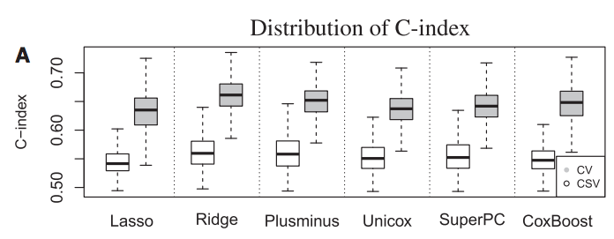
Cross-validation – side note
Cross-validation estimates assume that the sample is representative of the population
Bernau, C. et al. Cross-study validation for the assessment of prediction algorithms. Bioinformatics 30, i105–i112 (2014).

Slide 14
The Bootstrap – motivating example
Oral carcinoma patients treated with surgery
Surgeon takes “margins” of normal-looking tissue around to tumor to be safe
Varying numbers of “margins” for each patient are profiled for tumor-like gene expression alterations
Can a gene signature in histologically normal margins predict recurrence?
Reis PP*, Waldron L*, et al.: A gene signature in histologically normal surgical margins is predictive of oral carcinoma recurrence. BMC Cancer 2011, 11:437.

Slide 15
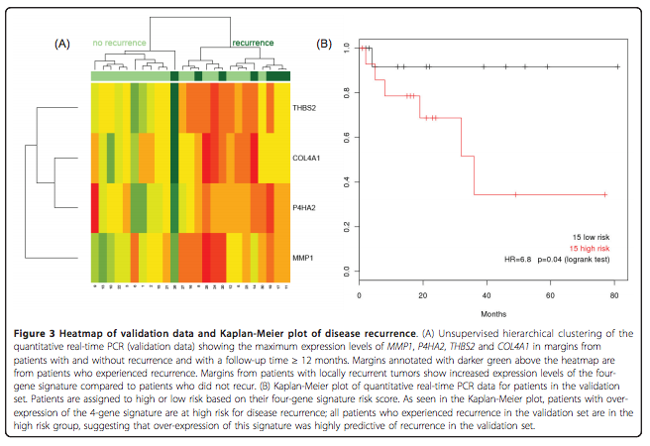
The Bootstrap – motivating example
Using maximum expression of ongogenic genes in any margin, the answer appears to be yes.

Slide 16
The Bootstrap – motivating example
The previous result used maximum expression of oncogenic genes from any margin
What if only one margin were profiled?
The distribution of any statistic in an arbitrarily complicated scenario can be estimated by the Bootstrap. From results:
Simulating the selection of only a single margin from each patient, the 4-gene signature maintained a predictive effect in both the training and validation sets (median HR = 2.2 in the training set and 1.8 in the validation set, with 82% and 99% of bootstrapped hazard ratios greater than the no-effect value of HR = 1)

Slide 17
The Bootstrap - HOWTO
Using the available sample (size n), generate a new sample of size n (with replacement)
Calculate the statistic of interest
Repeat
Use repeated experiments to estimate the variability of your statistic of interest

Slide 18
The Bootstrap - HOWTO
Using the available sample (size n), generate a new sample of size n (with replacement)
Calculate the statistic of interest
Repeat
Use the distribution of the statistic of interest across bootstrap experiments to estimate standard error, confidence intervals, statistical significance, etc.

Slide 19
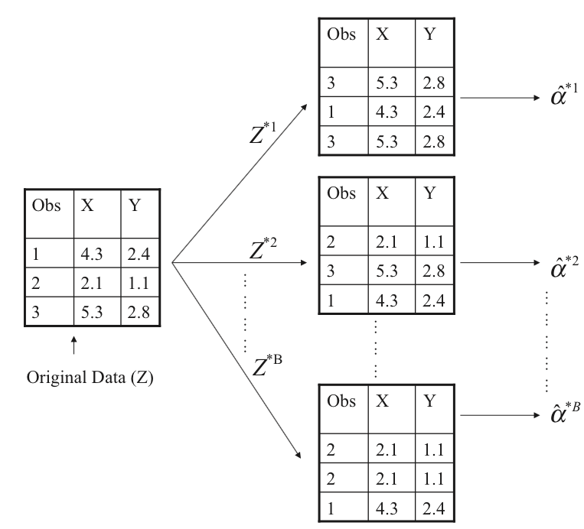
The Bootstrap (schematic)
ISLR Figure 5.11: Schematic of the bootstrap

Slide 20
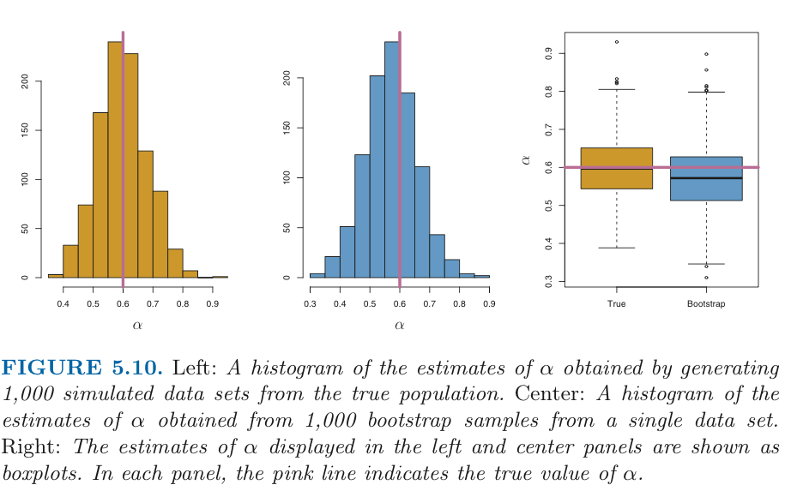
The Bootstrap: results

Slide 21
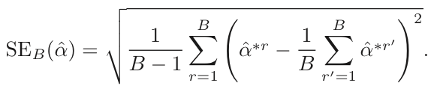
The Bootstrap: results
If bootstrap distribution is normally distributed, the standard error is the usual:
But normal distribution is not a requirement
Can use percentile method to estimate Confidence Intervals (requires many more simulations)
Bias-corrected percentile method corrects for bias between observed statistic and median of Bootstrap estimates

Slide 22
Resampling: Summary
Bootstrap for inference and CI estimation, CV for prediction accuracy
Bootstrap relaxes the assumptions often needed for analytical hypothesis tests
From lab:
the boot library automates bootstrap for glm() procedures
cvTools library assists with creating partitions, and automates CV for lm() procedures

